Slide 1
Training & Development
Chapter 7
1 | 2 | 3 | 4 | 5 | 6 | 7 | 8 | 9 | 10 | 11 | 12 | 13 | 14 | 15 | 16 | 17 | 18 | 19 | 20
21 | 22 | 23 | 24 | 25 | 26 | 27 | 28 | 29 | 30 | 31 | 32 | 33 | 34 | 35 | 36 | 37 | 38 | 39 | 40
41 | 42 | 43 | 44 | 45 | 46 | 47 | 48 | 49 | 50 | 51 | 52 | 53 | 54 | 55 | 56 | 57 | 58 | 59 | 60
61 | 62 | 63 | 64 | 65 | 66 | 67 | 68 | 69 | 70 | 71 | 72 | 73 | 74 | 75 | 76 | 77 | 78 | 79 | 80

Slide 2
Overview
Module 7.1 – Foundations of Training & Learning
Module 7.2 – Training Methods
Module 7.3 – Training Evaluation
Module 7.4 – Specialized Training Programs

Slide 3
Foundations of Training & Learning
Module 7.1

Slide 4
What is Training?
A _________________ attempt to increase knowledge and skill or choice behavior through __________ instruction and learning
Can be organization-focused or person-focused
Is becoming more complex – the focus is on development instead of training
Is becoming more informal

Slide 5
Importance of Training
Organizations invest significant resources in training and development (T&D) – ATD State of the Industry Reports
$164.2 billion spent on T&D in 2012 (last report w/ total estimate), representing $1,195 & 30.3 learning hours per employee in 2012
$1,208 & 31.5 learning hours per employee in 2013
$1,229 & 32.4 learning hours per employee in 2014
$1,252 & 33.5 learning hours per employee in 2015
Average cost/learning hour is ~$82 across 2012-2015
Most commonly training supervisory or managerial skills
Because of the “skill gap,” training will be more important as time goes on

Slide 6
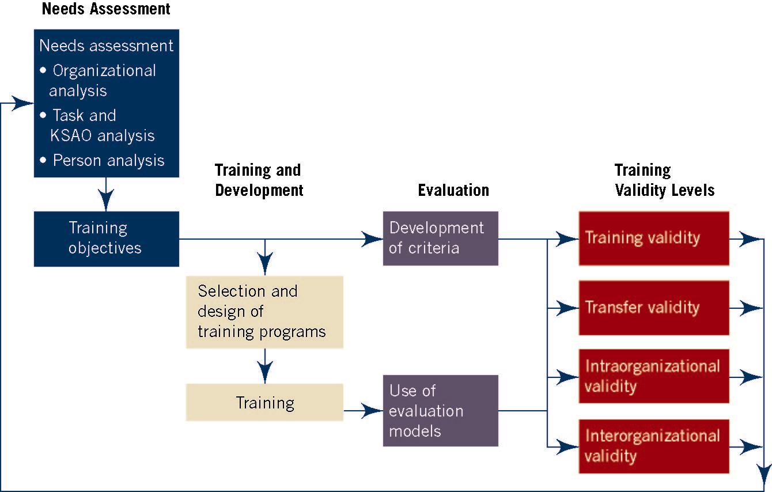
Goldstein & Ford’s (2002) Training Model

Slide 7
Training Needs Assessment (TNA)
What should the training accomplish
…in terms the organization’s goals?
…in terms of the specific tasks?
…in terms of the people involved?
Accomplish this using systematic analysis
Surveys
Critical Incidents
Cognitive Task Analysis
Usually ignored by “vendors”

Slide 8
Common Training Needs
Work Readiness Skills
Self-Directed Learning Skills
Adaptability Skills
Teamwork Capabilities
Expatriate Skills
Critical Leadership Capabilities
(Campbell & Kuncel, 2002; Manpower Group, 2015; Payscale, 2016)

Slide 9
Baldwin & Ford (1988) – Model of Learning & Transfer Process
Inputs
Outputs
Transfer
Trainee Characteristics
Ability
Personality
Motivation
2
4
Training Design
Principles of Learning
Sequencing
Training Content
Learning & Retention
Generalization & Maintenance
1
6
Work Environment
Support
Opportunity to Use
3
5

Slide 10
What is Learning?
“A relatively permanent change in knowledge or skill produced by experience” (Weiss, 1990, p. 172; I/O)
“A multidimensional process that results in a relatively enduring change in a person or persons…physically, psychologically, and socially” (Alexander et al., 2009, p. 186; Ed Psych)
“A relatively permanent change in human capabilities that can include knowledge, skills, attitudes, behaviors, and competencies that are not the result of growth processes.” (Noe, 2013, p. 152)

Slide 11
Learning outcomes
Cognitive
Verbal knowledge
Declarative knowledge (DK) – knowing what
Procedural knowledge (PK) – knowing how
Strategic/tacit knowledge – knowing which, when, and why
Knowledge organization – mental models
Cognitive strategies or metacognition – management of thinking and learning process
Foundation for skill development
Kraiger, Ford, & Salas (1993)

Slide 12
Learning outcomes
Skill-based (based on Anderson’s 1982 ACT* model)
Initial skill acquisition – initial attempts at skill; error prone
Compilation – with practice individual steps combined and fewer errors
Automaticity – with A LOT of practice skill performed quickly w/ no errors
Affective
Attitudinal – internal state that influences choice of personal action (e.g., attitudes toward diversity)
Motivational
Goal orientation
Self-efficacy
Goal-setting
Kraiger, Ford, & Salas (1993)

Slide 13
Learning Theory – Skinner’s Reinforcement Theory
Learning results from the association between behaviors and rewards
Positive reinforcement increases likelihood of a behavior
Trainer identifies what outcomes the learner finds most positive and negative
Link outcomes to learners acquiring knowledge, skills, or changing behaviours
Can withhold or provide job-related, personal, and career-related benefits to learners who master program content

Slide 14
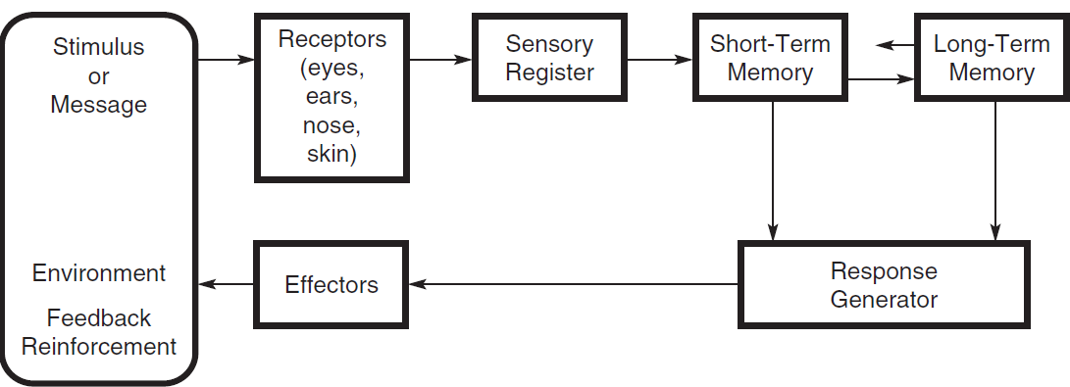
Learning Theory – Information Processing Theory

Slide 15
Information Processing Theory
Emphasizes internal processes that occur when training content is learned and retained
Highlights external events influencing learning
Changes in the intensity of the stimulus affect attention
Informing the learner of the objectives establishes an expectation
Enhancing perceptual features of the material to draw learner’s attention
Verbal instructions, pictures, diagrams, and maps suggest ways to code training content for storage
Meaningful learning context → cues that facilitate coding
Demonstrations/instructions help organize learner’s response & facilitates selection of correct response

Slide 16
Learning Theory – Bandura’s Social Learning Theory
Recognizes that behavior that is reinforced tends to be repeated
Emphasizes that people learn by observing others (models) whom they believe are credible and knowledgeable
Feeling self-efficacious increases likelihood of behavior
Person’s self-efficacy can be increased using several methods
Performance accomplishments
Vicarious experience
Verbal persuasion
Emotional arousal

Slide 17
Learning Theory – Bandura’s Social Learning Theory
Attention
• Model Stimuli
• Trainee Characteristics
Retention
• Coding
• Organization
• Rehearsal
Motor
Reproduction
• Physical Capability
• Accuracy
• Feedback
Motivational
Processes
• Reinforcement
Match
Modeled
Performance

Slide 18
Learning Theory – Lock & Latham’s Goal Setting Theory
Assumes that behavior results from a person’s conscious goals and intentions
Goals influence a person’s behavior by:
Directing energy and attention
Sustaining effort over time
Motivating the person to develop strategies for goal attainment
Learning facilitated by
Goal setting – _________________ goals are best
__________ – knowledge of results enhances motivation, learning, and performance

Slide 19
Learning Theory – Knowles’ Adult Learning Theory
Andragogy – “art and science of helping adults learn” (Knowles, 1980, p. 43)
Developed out of a need to explain how adults learn
Assumptions of the theory
Adults have a need to be self-directed.
Adults bring more work-related experiences into the learning situation.
Adults’ readiness to learn is oriented to their social role
Adults are oriented toward a problem or current performance, and therefore immediate application of learning
Adults need to know why they are learning something
Adults are motivated to learn by internal and external factors

Slide 20
Principles of Learning
Active practice!
Actively participating in training/work tasks
Massed practice
Individuals practice task continuously & without rest (e.g., cramming for test)
Distributed (Spaced) practice
Rest intervals between practice sessions
Generally results in more efficient learning & retention than massed practice

Slide 21
Principles of Learning
Whole learning
When entire task is practiced at once
More effective when complex task has relatively high organization
Part learning
When subtasks are practiced separately & later combined
More effective when complex task has low organization
e.g., surgeons & pilots

Slide 22
Fidelity
Extent to which task trained is similar to task required by job
Physical fidelity
Extent to which training task mirrors physical features of task performed on job
Psychological fidelity
Extent to which training task helps trainees develop KSAOs necessary to perform job

Slide 23
Training’s Ultimate Criterion – Transfer
___________________ – degree to which trainees effectively apply the knowledge, skills, and attitudes gained in a training context to the job (Baldwin & Ford, 1988)
Generalization
Maintenance
Near Transfer
Far Transfer
Initiation
Maintenance

Slide 24
Training’s Ultimate Criterion – Transfer
Why is this so difficult?
Trainees never learned it in the first place
Learned it, but did not retain it
Retained it, but did not recognize when to use it
Recognized when to use it, but lacked self-efficacy to do so
Plenty of self-efficacy, but had no motivation to use it

Slide 25
What Affects Learning & Transfer?
THE DESIGN
Transfer Principle | Emphasis | Appropriate Conditions | Type of Transfer
Identical elements | Training environment is identical to work environment. | Training focus: closed skills Work environment: predictable & stable Example: Equipment use | Near
Stimulus generalization | General principles are applicable to many different work situations. | Training focus: open skills. Work environment: unpredictable & variable Example: Training in interpersonal skills. | Far
Cognitive theory | Meaningful material and coding schemes enhance storage and recall of training content. | All types of training and environments. | Near and far

Slide 26
What Affects Learning & Transfer?
THE INDIVIDUAL
“Readiness”
Motivation
Ability, Personality
Experience
Goal Orientation
Motivated to attend training
Motivated to do well in training
Motivated to apply training to job

Slide 27
What Affects Learning & Transfer?
THE ENVIRONMENT
Support
Climate
Opportunity

Slide 28
Training Methods
Module 7.2

Slide 29
How Should We Train?
Think back to a class or a lesson plan where:
The information just didn’t seem to stay with you
You still remember vividly what you learned
What was it that helped you (or prevented you) from remembering?

Slide 30
What Methods Should We Use?
People remember…
10% of what they read
20% of what they hear
30% of what they see (e.g. videos)
50% of what they hear & see
70% of what they say & write
90% of what they say & do

Slide 31
Common Types of Training
On-Site Methods
“Off-Site” Methods
On-the-job training
Apprenticeship
Job Rotation
Presentation Methods
Lecture
Audio-visual presentations
Hands-on Methods
Practice
Programmed Instruction/Self-directed learning
Simulations
Case studies
Role plays

Slide 32
Web-based Training
Best of several worlds
Problems
Can be conducted on-site or off-site
Can include a combination of other methods
Can offer automated individualized attention
Can provide real-time feedback
Can be updated system-wide in real time
Comparative effectiveness is unknown
Technological roadblocks
Unknown moderators

Slide 33
effectiveness of web-based (WBI) & classroom instruction (CI)
Outcome | k | N | d | SE_{d}
Reactions
WBI vs. CI | 22 | 2,580 | .00 | .05
Blended vs. CI | 11 | 1,769 | -.15* | .06
Declarative Knowledge
WBI vs. CI | 71 | 10,910 | .15* | .02
Blended vs. CI | 33 | 6,799 | .34* | .03
Procedural Knowledge
WBI vs. CI | 12 | 944 | -.07 | .07
Blended vs. CI | 6 | 507 | .52* | .09
Sitzmann et al. (2006)
Notes:
Positive effect size, WBI more effective; Negative effect size, CI more effective

Slide 34
Training evaluation
Module 7.3

Slide 35
Evaluating Training – Kirkpatrick
Reaction Criteria
Did the trainee like the training?
Most common measure
Affective vs. Utility reactions (Alliger et al., 1997)
Learning Criteria
Did the trainee learn anything from the training?
Immediate knowledge, knowledge retention, behavior/skill demonstration (Alliger et al., 1997)

Slide 36
Evaluating Training – Kirkpatrick
Behavioral Criteria
Did the training cause any changes in behavior?
Also called transfer
Results Criteria
Did the training change any organizational outcomes?
Least common measure

Slide 37
Relationships Among Criteria
 | r (k)
Construct | 1 | 2 | 3 | 4
1. Affective Reactions
2. Utility Reactions | .34 (3)
3. Immediate Learning | .02 (11) | .26 (6)
4. Retention | n/a | n/a | .35 (2)
5. Transfer | .07 (6) | .18 (3) | .11 (16) | .08 (4)
From Alliger et al. (1997)

Slide 38
Effectiveness of Training
Type of Effects | Average gain (d) | k (N)
Reactions | .60 | 15 (936)
Learning | .63 | 234 (15, 014)
Behavior | .62 | 122 (15,627)
Results | .62 | 26 (1,748)
From Arthur et al. (2003)

Slide 39
Group Discussion
What is the best way to evaluate student performance in the classroom (i.e. a college course)?

Slide 40
Training Evaluation Designs
__________________________________ – strongest training evaluation design
Random assignment of participants to conditions
Control group
Measures obtained before & after training
Other designs may be better due to practical/resource constraints

Slide 41
Specialized Training Programs
Module 7.4

Slide 42
Management & Leadership Development
Assessment centers
Evaluate organizational, leadership, & communication skills
Managers with high potential generally invited to participate
360 degree feedback
Received positively & effective at improving performance

Slide 43
Management & Leadership Development
Coaching/Mentoring
Practical, goal-focused form of personal, one-on-one learning for busy professionals
Practical, flexible, targeted form of individualized learning for managers/executives
Informal training
Include specific job assignments, experiences, & activities outside work

Slide 44
Sexual Harassment Training
Forms of harassment
Quid pro quo
Hostile working environment
EEOC encourages following steps:
Clearly communicate a zero tolerance policy
Establish an effective grievance process
Take immediate & appropriate action when employee complains

Slide 45
Sexual Harassment Training
Supervisors should receive additional training beyond what employees receive
Effective in increasing knowledge of & ability to identify sexual harassment
More field research necessary to understand short- & long-term effects

Slide 46
Ethics Training
Appropriate approach likely is to use both selection & training to increase likelihood that employees will perform jobs ethically

Slide 47
Cross-Cultural Training (CCT)
Critical in helping expatriates adapt to new environments
Symptoms of culture shock
Homesickness
Irritability
Loss of ability to work effectively

Slide 48
Cross-Cultural Training
Cross-Cultural Training
Designed to prepare individuals from one culture to interact more effectively with individuals from different cultures
Cultural assimilator
Culture-specific assimilator
Culture-general assimilator

